Slide 1
Open Education Technologies
Alfredo Soeiro
EDEN Webinar
University of Porto and EDEN Executive Board
4Mar20, 13h CET

Slide 2
Case study
Project financed by Eramus+
Construction Safety Education and Training using Immersive Reality
4 universities and one construction company
3 years
Half million Euros
ISHCCO, AECEF, ENETOSH and others invited to validate and tune up
http://csetir.civil.auth.gr/

Slide 3
Training as Zero Vision mechanism
Worker
  – Aware of risks
Engineer
– Implementation of measures
Safety coordinator
    – Promote prevention
Safety technicians
  – Implementation of prevention
Construction owner/client
  – Pay for prevention

Slide 4
Digital Tools
BIM (Building Information Model)
Smartphone/tablet/mobile device
3D Glasses
Immersive reality

Slide 5
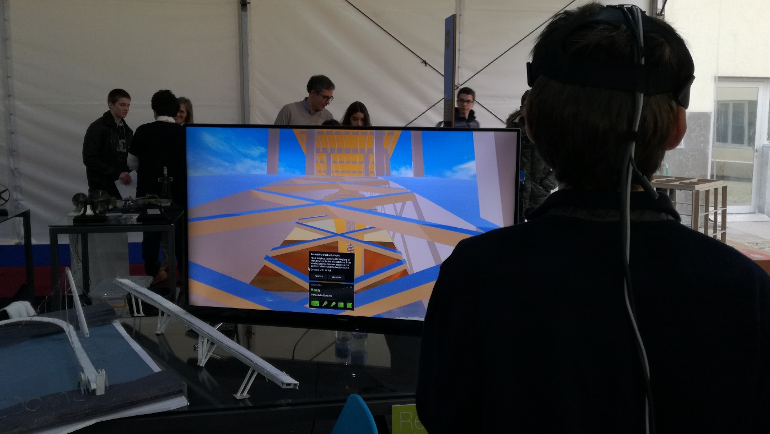
Digital Tools

Slide 6
Combination Training and Digital
Static
Scenarios
Dynamic
Game
Interactive
  Simulation

Slide 7
Methodology
Construction tasks addressed at any time
Risks associated from planning and statistics
Visualization of environment
Static, dynamic or interactive participation
Learning/training induced by knowledge
Generic in terms of users

Slide 8
Conclusions
Simulation as training and education facilitator
Possible use in certification
Adjusted to each situation
Standardising of training possible
Adjustable to exisiting budget
Use on site or on training facility
Possibilities are immense

