Slide 1

TA-SE 6th General Assembly and
2nd Policy Forum
Bangkok, 9 October 2019
Competences and Assessment for Academics and Professionals.
An example to follow?
Alfredo Soeiro
University Porto

Slide 2

Towards a more reliable model for evidence based learning and quality assurance and enhancement
Twenty-first Century Challenges
Millions of students finish university education every year. They enter the labour market with sets of competences based on their personal experiences and their studies.
  Are they really prepared for the jobs they go after?
  What are the demands of employers?
  Are they equipped to fully engage with their civic responsibilities?
Are universities up to speed?
Do existing quality assurance instruments offer sufficient evidence to answer those questions?
Can institutional performances be compared to identify best practices?

Slide 3
RATIONAL: Additional instrument needed !
Present instruments for measuring ‘quality’:
Offer limited evidence of what is learned and at what level
QA is mainly process oriented not really outcome focused
QA is looking backward not forward: lack focus on future needs of society and the graduate
Offer limited evidence about the real quality and relevance of degree programmes and their performance

Slide 4
European response to these challenges:
”Measuring and Comparing Achievements of Learning Outcomes in Higher Education in Europe” (CALOHEE)
WHY CALOHEE?
Preposition:
If academic and professional experts can agree on the set of learning outcomes, they should also be able to measure performance in comparative perspective in (inter)national contexts!

Slide 5

WHY? HOW? WHAT?
Meeting the demand for more reliable information about the outcomes of learning in Higher Education
Offering a drive for quality, taking fully into account the needs of society, in particular the four major stakeholders: HE students, HE staff and management, employers and employees, and civil society
An attempt to create (in the longer run) a more effective, less bureaucratic and more reliable instrument for quality assurance !

Slide 6

WHY? HOW? WHAT?
By showing what a subject area represents after consultation of stakeholders, in terms of core competences and learning outcomes according to the discipline
By developing instruments that acknowledge the different types of outcomes by using proper assessment methods

Slide 7
WHY? HOW? WHAT?
One page set of Learning Outcomes descriptors per discipline based on a merger of EQF for LLL and QF for the EHEA described in terms of dimensions
Assessment Frameworks offering detail of what can be / should be learned
The CALOHEE Assessment Model
A Reference Framework for Civic, Social and Cultural Engagement

Slide 8
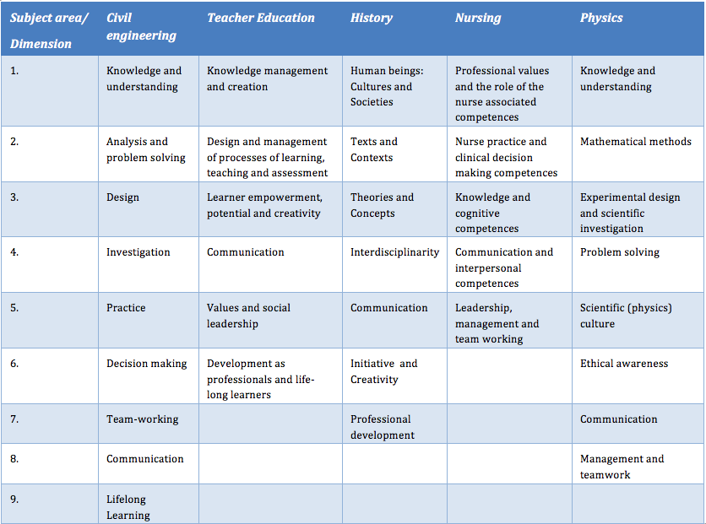


1. Do justice to the character of specific academic domain
2. Structures sets of learning outcomes in a logical way
3. Allows for combining existing frameworks
CALOHEE Dimensions model

Slide 9
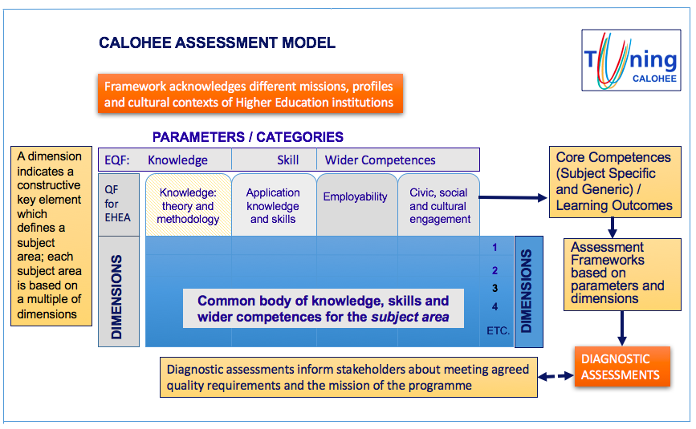

Slide 10

Simple problem…?
Learning Outcomes
Assessment

Slide 11


Slide 12
Example from CALOHEE
Dimension 6: Decision making
 | Knowledge | Skills | Wider Competences (Responsibility and Autonomy)
Level descriptor | Demonstrate awareness of the key aspects of professional, ethical and social responsibilities linked to management of civil engineering activities, decision making and judgment formulation. | Manage work contexts in civil engineering subject area, take decisions and formulate judgments. | Identify appropriate and relevant approaches to manage work contexts in civil engineering subject area and reflect on professional, ethical and social responsibilities in taking decisions and formulating judgments.
Assessment approaches | Essays Problem Solving Practical Work | Essays Problem Solving Practical Work | Problem Solving Practical Work Reflective Practice Assignments

Slide 13
IN SUM: CALOHEE offers
Academic and professional engagement
Subject focused context
Evidence based tools for analysis and diagnosis
Provide support to stakeholders
Serve European HE degrees
A challenging endeavour with high potential !

Slide 14

https://www.calohee.eu
CALOHE2 - implementation
CALOHEX – five other areas

